Slide 1
Accelerating Medicines Partnership Parkinson’s Disease (AMP-PD) Progression Prediction
Analysis of Protein and Peptide Levels Over Time to Predict Progression of Parkinson’s Disease
Ruixin Lou, Emmanuel Ruhamyankaka, Sukhpreet Sahota, & Jiaxin Ying

Slide 2
Steve’s Story
Steve is a successful lawyer; on a seemingly normal night at the office, as Steve prepared to depart, he felt a sensation in his right arm that he noted but didn’t think much of. A month later, he noticed diminished dexterity in his right hand but again, dismissed anything extreme and considered it as another coincidence. A few days later, while out for a run, he knew something was truly wrong as he felt abnormally fatigued, and experienced unfamiliar pains and stiffness in his right shoulder, immediately followed by involuntary twitching in his right arm. “Steve grimaced at the thought. ‘Now I know I have to see a doctor. So I go on my own, not wanting to alarm anyone. And very quickly, one thing leads to another. And then a doctor tells me, ‘I think you may have Parkinson's.

Slide 3
Parkinson’s Disease by the Numbers!
A Progressive Neurological Disorder that affects millions of people, like famed actor Michael J. Fox, worldwide.
According to the Parkinson’s Foundation, more than 10 million people worldwide have been diagnosed with Parkinson’s Disease, 1 million of whom currently reside in the United States
90,000 new Parkinson’s Disease diagnoses are made in the US every year, at which rate, 1.2 million individuals will be diagnosed with the disease by 2030

Slide 4
AMP-PD Progression Prediction
Kaggle Competition
Objective
Goal
Use advanced machine learning algorithms to predict Parkinson's Disease progression using clinical trial data, protein data, and peptide data
Predict the MDS-UPDRS scores for patients to determine Parkinson’s Disease

Slide 5
Two Types of Symptoms Measured by MDS-UPDRS Scale
Non-motor
Part I - Non-Motor Aspects of Experiences of Daily Living (nM - EDL)
Motor
Part II - Motor Aspects of Experiences of Daily Living (M-EDL)
Part III - Motor Examination
Part IV - Motor Complications
Total Score Range:
0 - 272

Slide 6
01
Exploratory Data Analysis

Slide 7
Dataset Overview
248 unique patients made
2,615 clinical visits
227 unique protein structures
968 different peptide bonds
Clinical Trial Data
Peptide and Protein Data

Slide 8
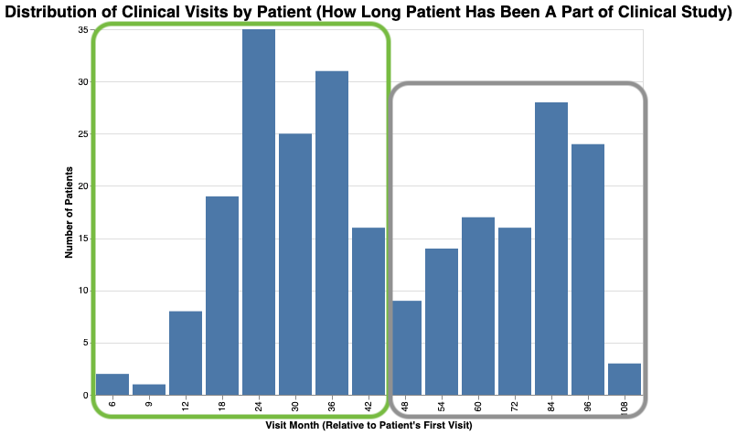
Duration Patient has been Part of Clinical Trials

Slide 9
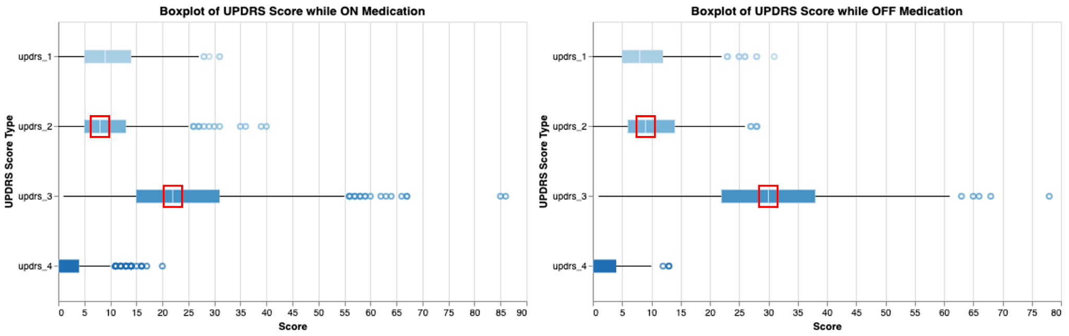
MDS-UPDRS Score Based on Medication Status

Slide 10
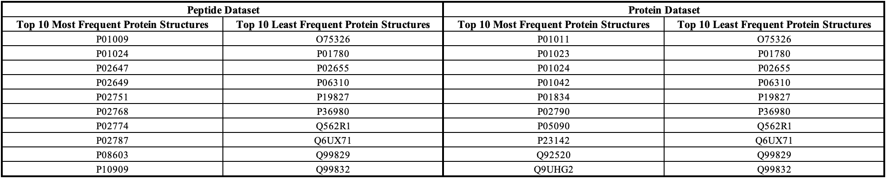
Top 10 Most and Least Frequent Protein Structures

Slide 11
02
Experiments

Slide 12
The five stages of methodology
Stage 1
Stage 3
Stage 5
Preprocessing data
Optimizing hyperparameters
Evaluating the test data for the lowest error.
Stage 2
Stage 4
Feature engineering
Getting the optimal hyperparameters

Slide 13
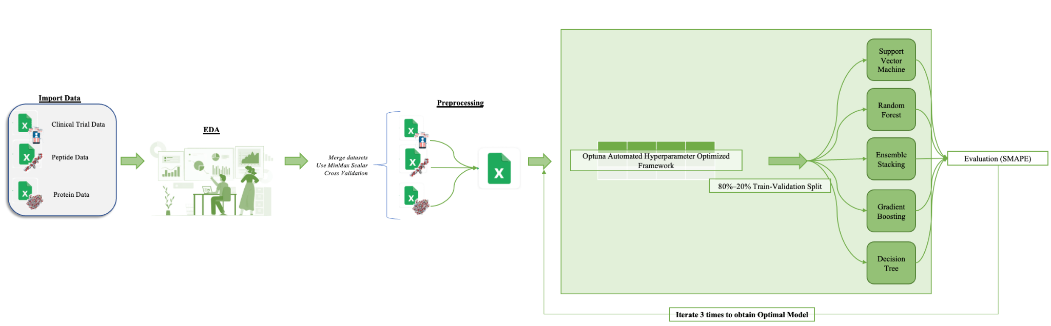
Flowchart of Steps Involving ML Techniques to Predict Parkinson’s Disease Progression

Slide 14
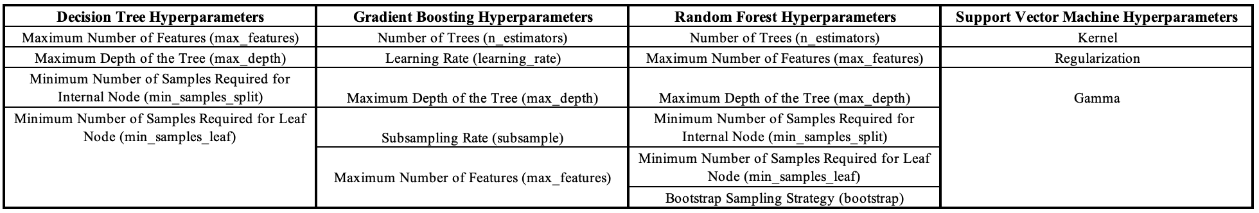
Steps of Experiments
Merge and preprocess clinical, peptide, and protein datasets using MinMaxScaler.
Evaluate four base models and a fifth ensemble stacking model through 10-fold cross-validation.
Optimize hyperparameters with Optuna, train models on 80/20 split, minimize SMAPE score, and run 100 trials to predict relative error in UPDRS scores.
Set of hyperparameters tuned for each selected model

Slide 15

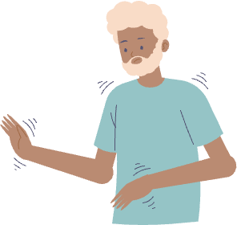
Experiments Conducted
Experiment #1
Experiment #2
Develop a model using UPDRS scores, clinical data, peptide, and protein levels for all patients to analyze short-term and long-term Disease progression.
Create two models for recently observed and established patients to analyze clinic visit duration's impact on progression. Compare prediction of UPDRS scores.

Slide 16
03
Results

Slide 17
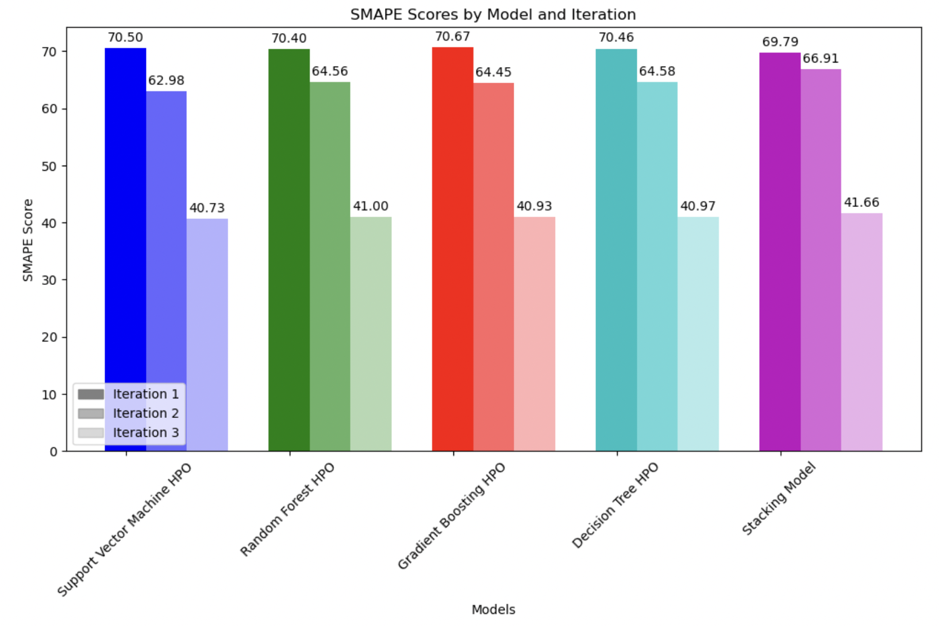
Experiment #1 Results
First Iteration
Random forest performed best
Next iterations..
Support Vector Machines performed the best from all of the models..
SMAPE Scores by Model for each Iteration.

Slide 18
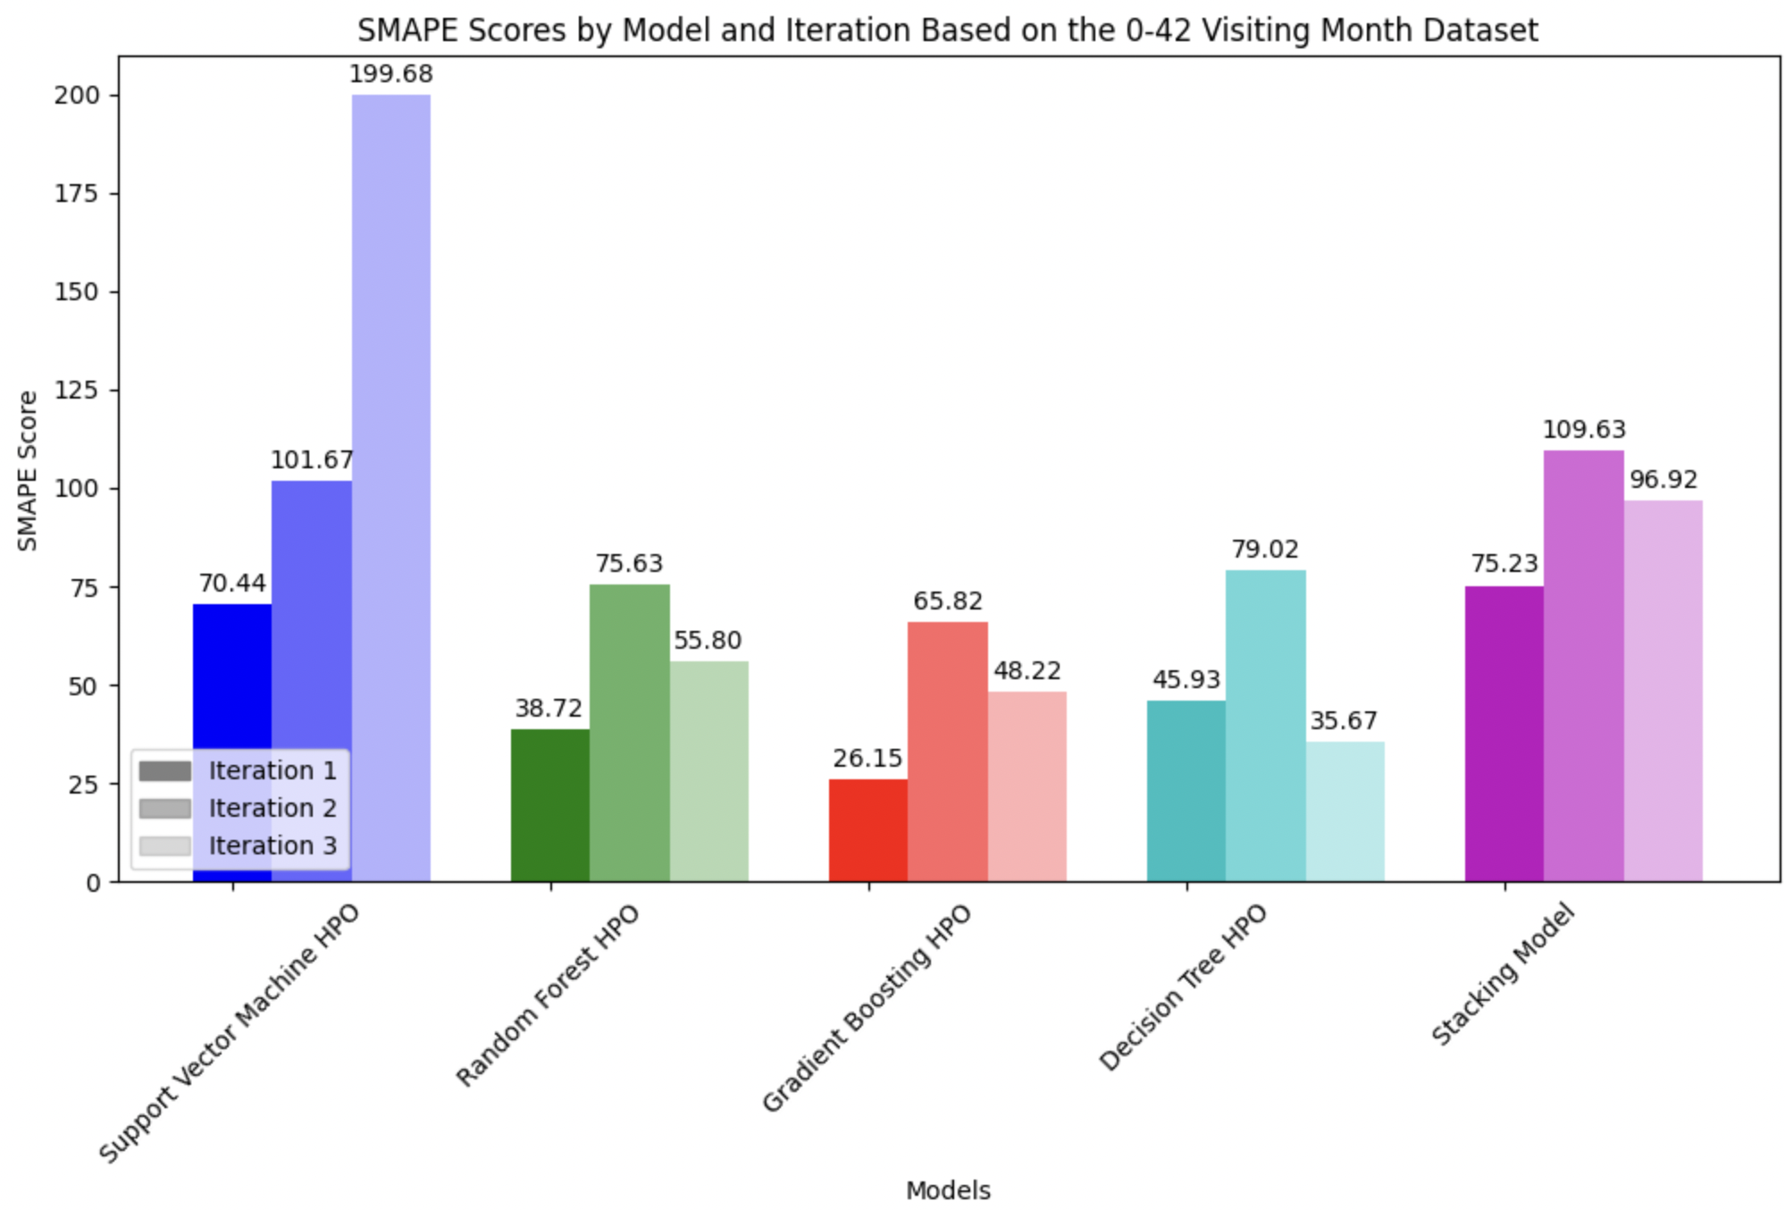
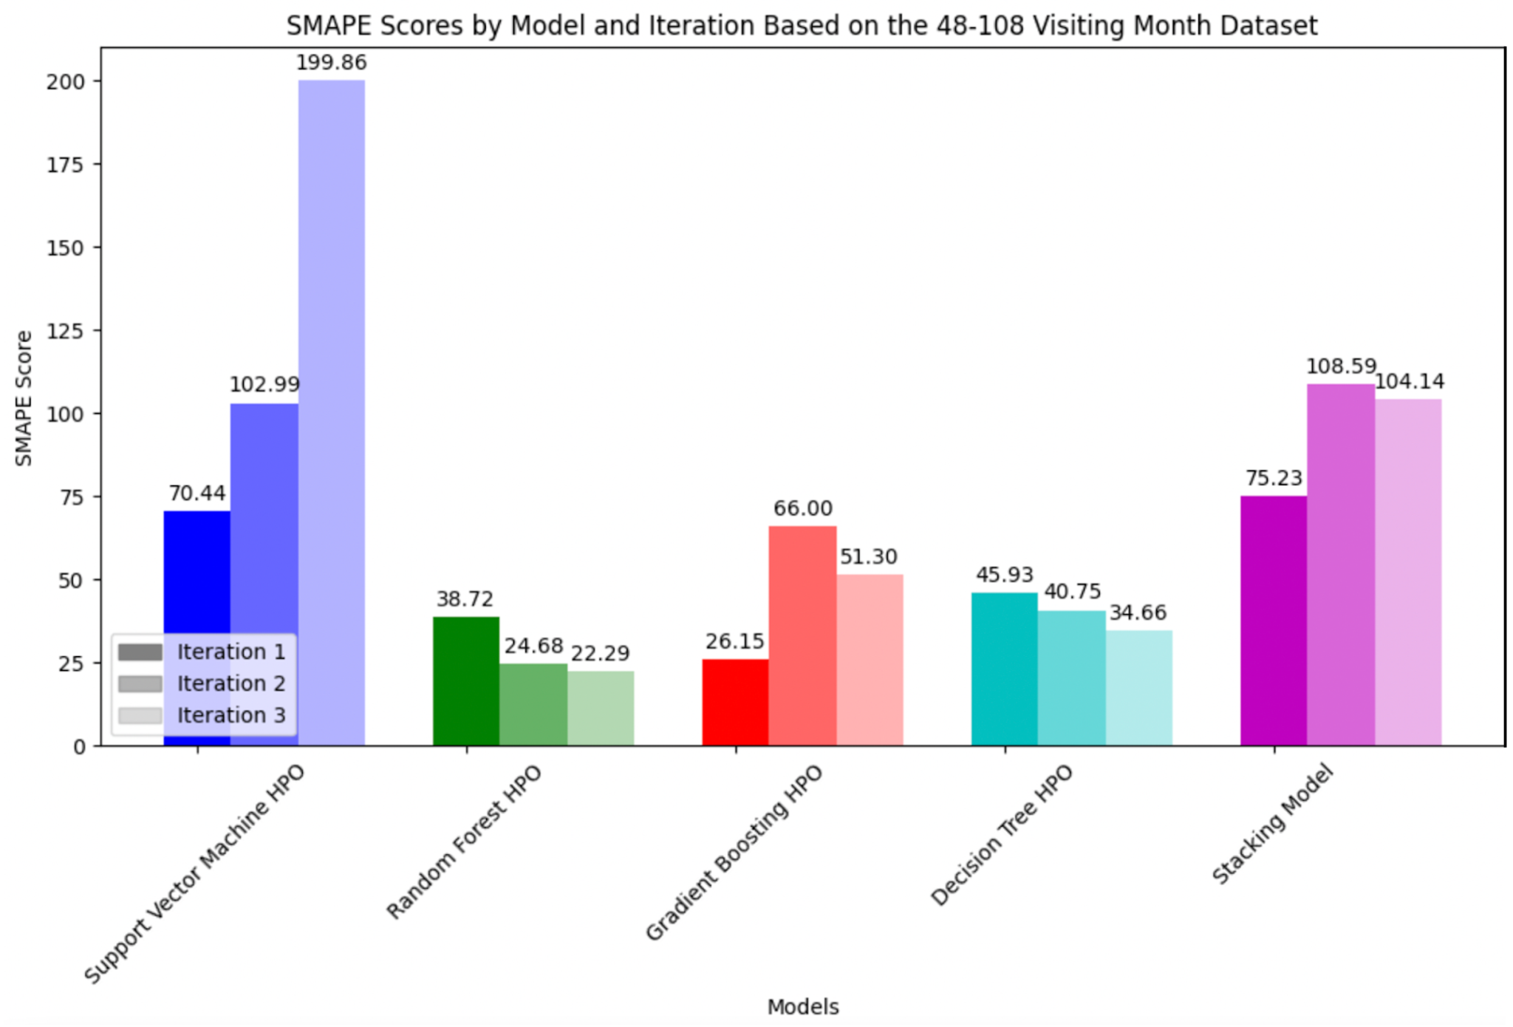
Experiment #2 Results

Slide 19
Test Results
The two optimal models that performed best on the collective dataset were Support Vector Machines and Ensemble Stacking.
SVM-optimized model garnered a SMAPE of 57.8.
Ensemble Stacking optimized model, which amassed a SMAPE of 57.2 and thus performed the best across all models we considered
In analyzing all patients in the dataset together, as represented by our second experiment, certain models may have advantages when analyzing the time the patient has been part of the clinical trials.
Short-term: Gradient Boosting and Decision Tree
Long-term: Random Forest

Slide 20
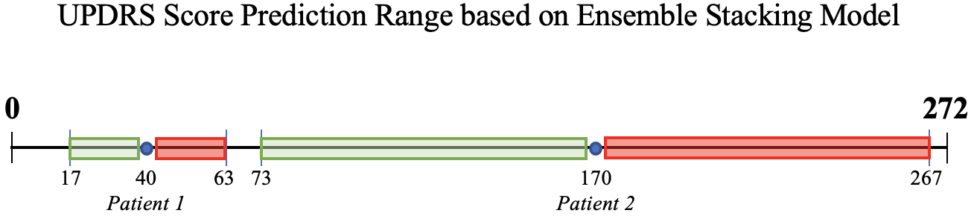
Interpreting SMAPE for Test Results
SMAPE accounts for the percentage of error within our predicted UPDRS score and the actual, observed UPDRS score. This, in turn, means that the total UPDRS score for a given patient will have a wider range and greater variance between the actual score and the predicted score
Illustrative example of two patients - Patient 1 has a predicted UPDRS score total of 40 while Patient 2 has a predicted UPDRS score total of 170. The respective ranges are calculated based on the SMAPE of 57.2. Hence, Patient 1’s actual UPDRS score could be between 17 to 63 while Patient 2’s actual UPDRS score could be between 73 to 267 (with a UPDRS score within the green range is preferred compared to a UPDRS score within the red range)

Slide 21
04
Conclusion

Slide 22

Conclusion
In conclusion, this project is an important step towards using machine learning techniques to aid in understanding Parkinson’s Disease progression.
This problem space cannot be resolved solely using one methodology, such as machine learning but requires cooperation among multiple specialities.
Our models can complement current medical procedures, eg. be used as a pre-screening tool to determine patients who may require more medical attention in the short term than the long term.
Limitations:
Our approach has limitations, such as limited domain expertise regarding Parkinson's Disease and a dataset with much missing data.
Future work should focus on collecting more data and partnering with medical professionals and organizations dedicated to finding a cure for Parkinson's Disease.

Slide 23


Thanks!
Do you have any questions?
Please keep this slide for attribution

